Slide 1

Fine Tuning of LLMS
Dr. Rakhee Chhibber

Slide 2
Agenda
https://www.llama.com/docs/how-to-guides/fine-tuning/
https://www.analyticsvidhya.com/blog/2023/10/hugging-face-fine-tuning-tutorial/
What is Fine tuning?
Fine Tuning Large Language Model (LLM)
Types of Fine Tuning Methods
Implementing Fine Tuning Large Language Model using DialogSum Database

Slide 3
What is fine tuning?
Fine-tuning allows a pre-trained model to adapt to a new task. This approach uses the knowledge gained from training a model on a large dataset and applying it to a smaller, domain-specific dataset. Fine-tuning involves adjusting the weights of the model's layers or updating certain parts of the model to improve its performance on the new task.
Fine-tuning is used in transfer learning where a is model trained on one similar task and is reused for another task often with minimal changes. The underlying assumption is that the model has already learned useful features in the original task that can be transferred and adapted to the new task hence reducing the need for training a model from scratch.

Slide 4
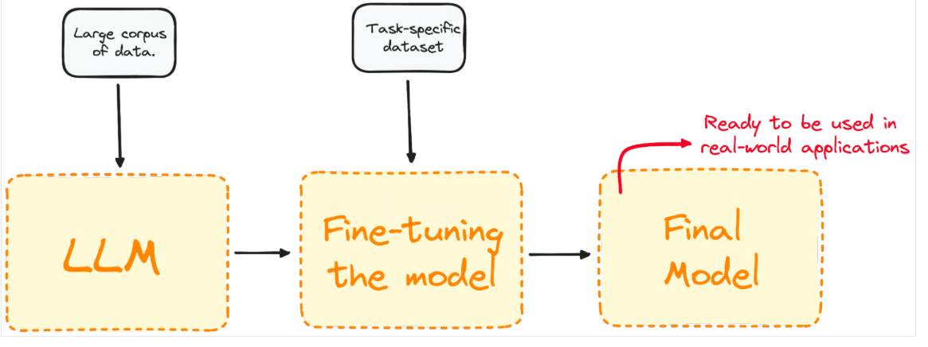

Slide 5
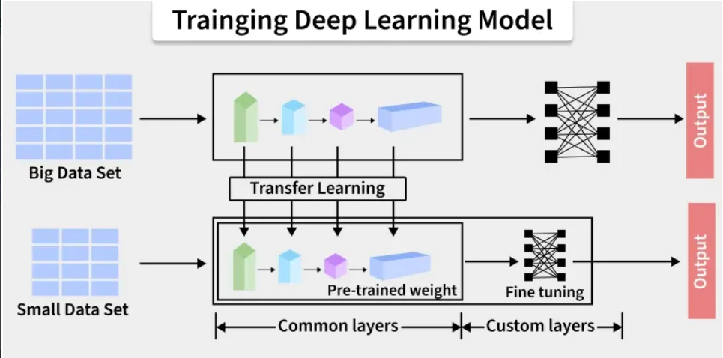

Slide 6
#PEFT.ipynb
import torch
from transformers import AutoModelForCausalLM, AutoTokenizer
model_id = "Qwen/Qwen2.5-3B-Instruct"
tokenizer = AutoTokenizer.from_pretrained(model_id)
model = AutoModelForCausalLM.from_pretrained(
model_id,
device_map="auto"
)

Slide 7
from transformers import AutoModelForCausalLM
from peft import LoraConfig, TaskType, get_peft_model
model_id = "Qwen/Qwen2.5-3B-Instruct"
model = AutoModelForCausalLM.from_pretrained(model_id, device_map=device)
peft_config = LoraConfig(
r=16,
lora_alpha=32,
task_type=TaskType.CAUSAL_LM,
# target_modules=["q_proj", "v_proj", ...] # optionally indicate target modules)
model = get_peft_model(model, peft_config)
model.print_trainable_parameters()
# prints: trainable params: 3,686,400 || all params: 3,089,625,088 || trainable%: 0.1193
# now perform training on your dataset, e.g. using transformers Trainer, then save the model
model.save_pretrained("qwen2.5-3b-lora")

Slide 8
from transformers import AutoModelForCausalLM, AutoTokenizer
from peft import PeftModel
#device = torch.accelerator.current_accelerator().type if hasattr(torch, "accelerator") else "cuda"
model_id = "Qwen/Qwen2.5-3B-Instruct"
tokenizer = AutoTokenizer.from_pretrained(model_id)
model = AutoModelForCausalLM.from_pretrained(model_id, device_map=device)
model = PeftModel.from_pretrained(model, "qwen2.5-3b-lora")
inputs = tokenizer("Preheat the oven to 350 degrees and place the cookie dough", return_tensors="pt")
outputs = model.generate(**inputs.to(device), max_new_tokens=50)
print(tokenizer.decode(outputs[0], skip_special_tokens=True))
# prints something like: Preheat the oven to 350 degrees and place the cookie dough in a baking dish [...]

Slide 9
Applications
Domain Adaptation – adapting a general pretrained model (e.g., GPT, BERT) to a specific domain like medical, legal, or finance.
Task Specialization – improving performance on a narrow task such as sentiment analysis, question answering, or named entity recognition.
Language/Style Customization – fine-tuning to handle specific languages, dialects, or writing styles.
Personalization – customizing a model to reflect user preferences, vocabulary, or tone.
Data Efficiency – leveraging a small dataset to teach a large model new knowledge instead of training from scratch.
Edge Deployment – compressing and fine-tuning smaller models for mobile/IoT use cases.

Slide 10
Advantages
Fine-tuning is beneficial when:
We have a limited dataset: Fine-tuning a pre-trained model helps achieve high performance even with small amounts of data.
We need domain-specific expertise: Adapting a pre-trained model on specialized datasets (like legal or medical text) improves accuracy for specific fields. For example a model trained on general images can be fine-tuned for medical image analysis hence improving accuracy by focusing on relevant features.
We want to save training time: Fine-tuning avoids training from scratch, making it a faster solution for time-sensitive projects.
Better Performance on Smaller Datasets: Training models on smaller datasets can often result in overfitting as the model has too few examples to learn from. Fine-tuning allows the model to generalize better by using the knowledge from the larger pre-trained dataset.

Slide 11
Challenges
Overfitting: Even though fine-tuning reduces the risk of overfitting compared to training from scratch it can still occur if the new dataset is too small or lacks diversity.
Computational Constraints: Fine-tuning may still require considerable computational resources especially when working with large models like GPT or BERT.
Selecting the Right Layers to Fine-Tune: Deciding which layers to freeze and which to train can be tricky. Some models may benefit from fine-tuning more layers while others might only require adjustments to the final layers.

Slide 12
How is Fine-Tuning Performed?
Select Base Model: Choose a pre-trained model based on our task and compute budget.
Choose Fine-Tuning Method: Select the most appropriate method like Instruction Fine-Tuning, Supervised Fine-Tuning, PEFT, LoRA, QLoRA, etc based on the task and dataset.
Prepare Dataset: Structure our data for task-specific training, ensuring the format matches the model's requirements.
Training: Use frameworks like TensorFlow, PyTorch or high-level libraries like Transformers to fine-tune the model.
Evaluate and Iterate: Test the model, refine it as necessary and re-train to improve performance.

Slide 13
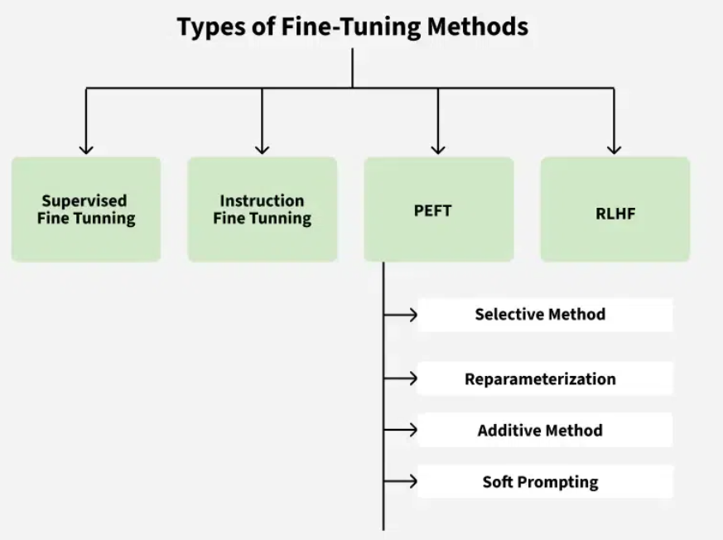
Types of Fine-tuning

Slide 14
1. Supervised Fine-Tuning
Further trains a pre-trained model on a task-specific labeled dataset (input-output pairs).
Updates all model weights to adapt it to the new task.
Best for tasks like sentiment analysis and text classification where labeled data is available.
https://medium.com/data-science-collective/supervised-fine-tuning-step-by-step-aefe6fbe5e09

Slide 15
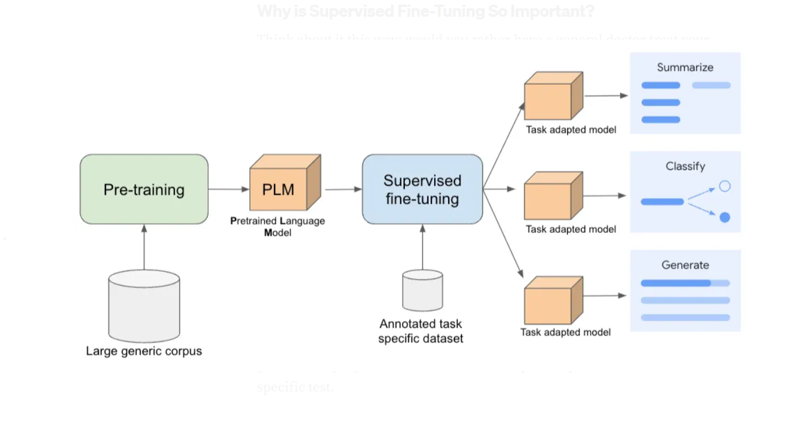

Slide 16
2. Instruction Fine-Tuning
Trains the model using datasets pairing instructions (prompts) with expected responses.
Helps the model generalize to new tasks and follow natural language instructions.
Commonly used in chatbots, question answering and open-ended tasks.

Slide 17
3. Parameter-Efficient Fine-Tuning (PEFT)
Adjusts only a small subset of parameters, keeping most of the model unchanged.
Methods include training adapter layers, low-rank reparameterization (LoRA) or just prompt tokens.
Enables efficient adaptation of large models with less memory and computation—for example, PEFT can reduce trainable parameters from tens of thousands to just a few thousand.

Slide 18
Types of PEFT
There are two important PEFT methods:
LoRA (Low Rank Adaptation) and
QLoRA (Quantized LoRA)
With a consumer-grade GPU, you can fine-tune a Llama 3.1 8B model with LoRA, and a Llama 3.3 70B model with QLoRA.

Slide 19
Low-rank adaptation (LoRA)
LoRA is a PEFT technique that reduces the number of trainable parameters by adding low-rank matrices to the network and only training those.
LoRA results in a significant reduction in the number of trainable parameters, making it more efficient in terms of both compute and memory requirements.

Slide 20
Advantages of LoRA
Reduced memory requirements: LoRA requires less memory to store the gradients and optimizer states, as only the low-rank matrices need to be updated.
Faster training: LoRA reduces the computational cost of fine-tuning, as the number of operations required to update the model's weights is significantly reduced.
Improved performance: LoRA can achieve comparable or even better performance than full fine-tuning, as the low-rank matrices can effectively capture the task-specific knowledge without losing the original model's knowledge.

Slide 21
Disadvantage
LoRA may struggle to fully adapt the model to tasks that require large changes in the internal representations, for example for substantially different domains or complex reasoning task

Slide 22
Quantized low-rank adaptation (QLoRA)
QLoRA is an extension of LoRA that further reduces the memory requirements by quantizing the model's weights and activations.
QLoRA uses a combination of quantization and low-rank adaptation to achieve even more efficient fine-tuning.

Slide 23
Advantages of QLoRA
Even lower memory requirements: QLoRA reduces the memory requirements even further by quantizing the model's weights and activations, making it possible to fine-tune larger models on limited hardware.
Increased efficiency: QLoRA achieves a better trade-off between memory requirements and performance, making it an attractive option for fine-tuning large models on resource-constrained devices.

Slide 24
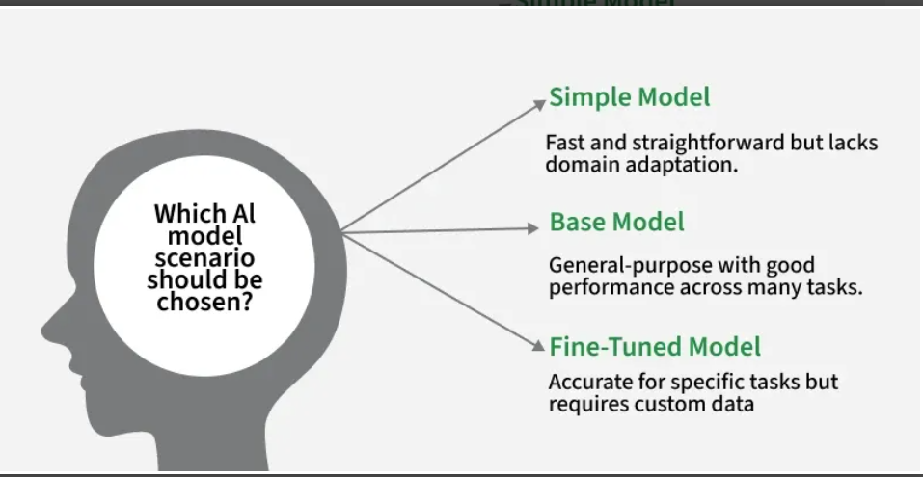
Simple vs Base vs Fine-Tuned Model

Slide 25
PEFT
https://github.com/huggingface/peft
PEFT is integrated with Transformers for easy model training and inference, Diffusers for conveniently managing different adapters, and Accelerate for distributed training and inference for really big models.
Prepare a model for training with a PEFT method such as LoRA by wrapping the base model and PEFT configuration with get_peft_model. For the bigscience/mt0-large model, you're only training 0.19% of the parameters!
PEFT.ipynb

Slide 26
LORA-Low Rank Adaptation

Slide 27
Introduction
Low-Rank Adaptation (LoRA) is a parameter-efficient fine-tuning technique designed to adapt large pre-trained models for specific tasks without significantly increasing computational and memory costs. As machine learning models become larger and more complex, fine-tuning them often requires substantial computational power and memory. LoRA addresses this issue by reducing the number of trainable parameters which makes the fine-tuning process faster and less demanding.

Slide 28
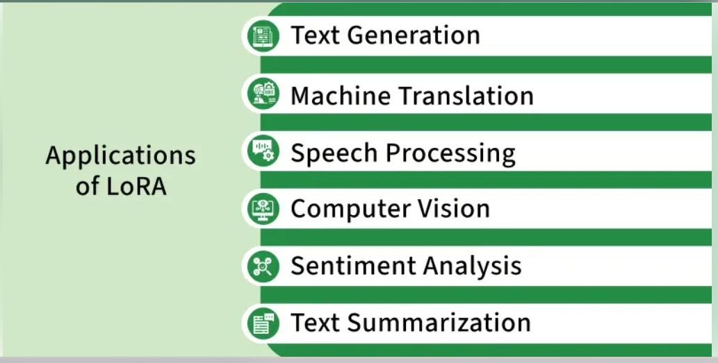

Slide 29
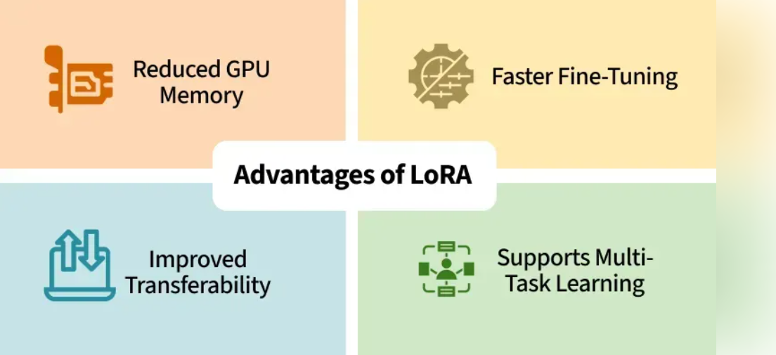

Slide 30
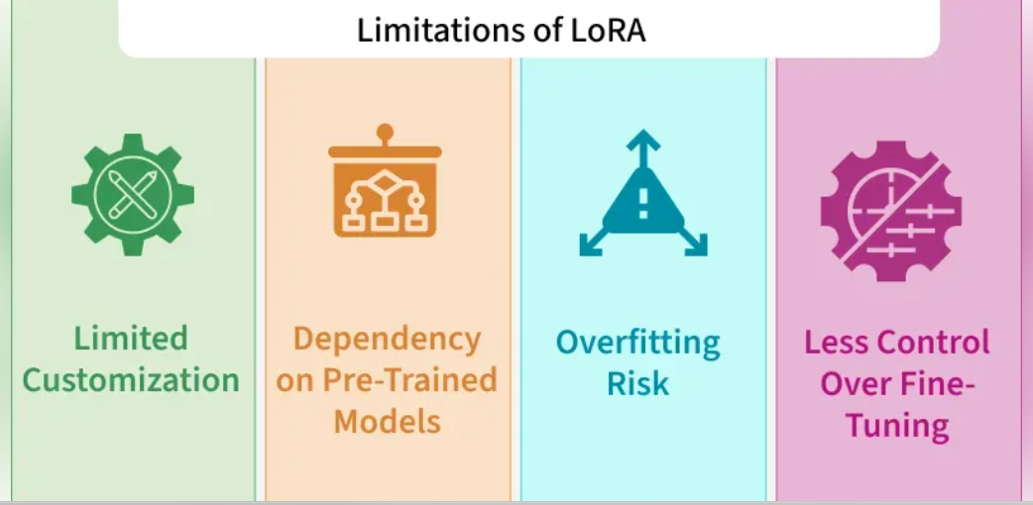

Slide 31
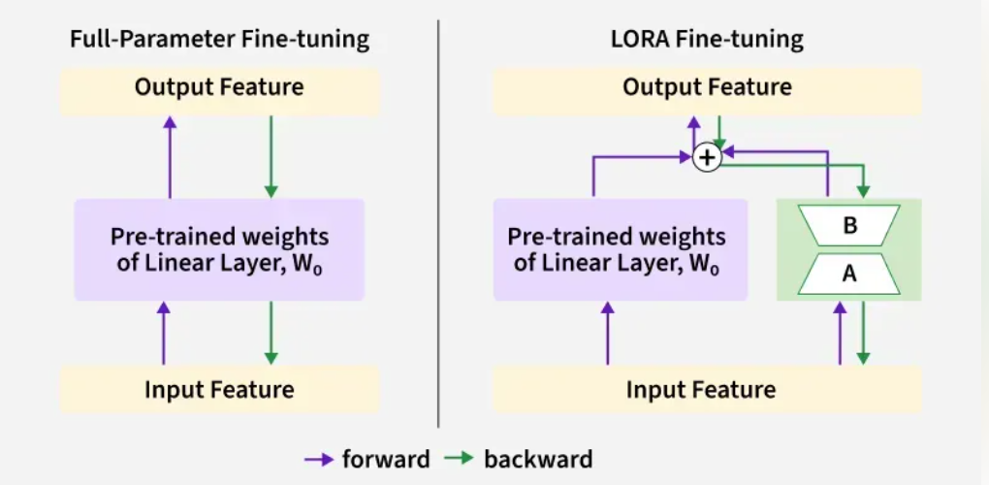

Slide 32
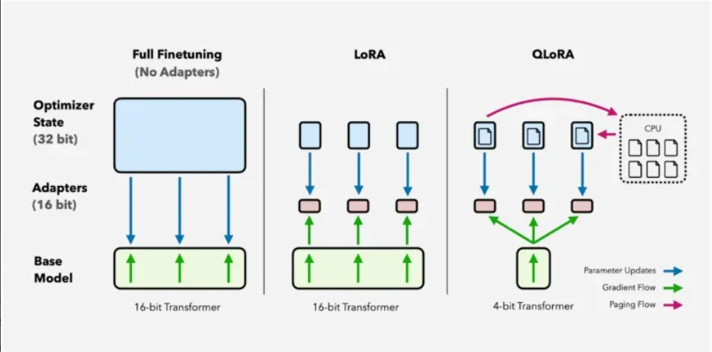

Slide 33
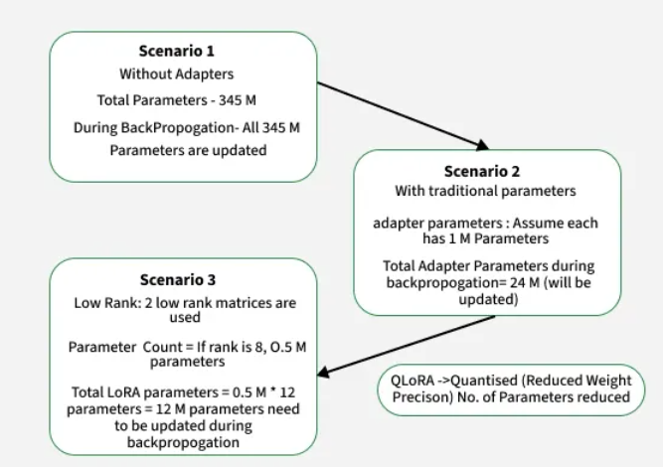
Scenario 1: Full finetuning All 345M model parameters are updated.
Scenario 2: Adapter tuning Only 24M adapter parameters are updated (1M per adapter × 24).
Scenario 3: LoRA Just 12M low-rank adapter parameters are updated (0.5M × 12 × 2).
QLoRA: Like LoRA, but with quantized (lower precision) weights, further reducing parameter count and memory use.

Slide 34
Architecture of LoRA
LoRA is used with transformer-based models which are common in NLP tasks.
Pre-Trained Backbone: We start with a large transformer model like GPT or BERT that has already been trained on a range of data.
Low-Rank Adaptation Layers: It adds small low-rank matrices to the model’s attention mechanism. These matrices are the only parts of the model that get updated during fine-tuning.
Frozen Original Parameters: The original weights of the model are kept frozen. This means we don’t modify the entire model, just the added low-rank matrices.
Task-Specific Fine-Tuning: We fine-tune the low-rank matrices for the specific task such as sentiment analysis or translation while the rest of the model stays the same.

Slide 35
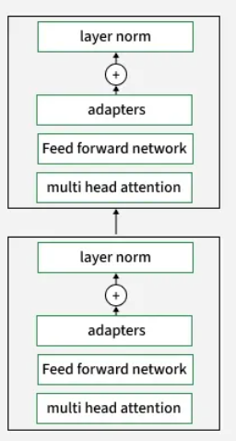
How LoRA (Low-Rank Adaptation) Works
This image shows a transformer block architecture where adapters are inserted after the feed-forward network and before layer normalization. In LoRA, these adapters are implemented as low-rank matrices. During fine-tuning, only these adapter parameters are updated, while the core model weights (multi-head attention, feed-forward network, etc.) stay fixed.
Adapters in the Stack: Each transformer block contains a small adapter module.
Parameter Update: Only the adapters (the low-rank matrices) are updated during training, greatly reducing the number of trainable parameters.

Slide 36
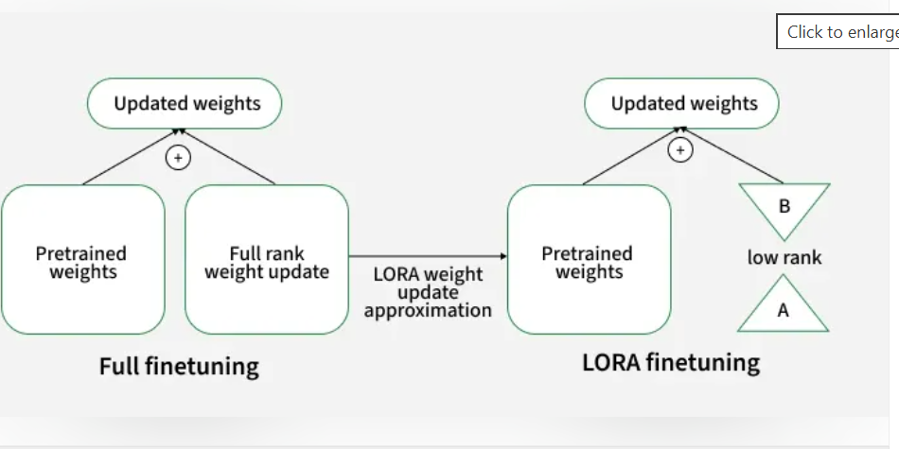

Slide 37

Working of LoRA
LoRA modifies the traditional fine-tuning process by introducing low-rank matrices into specific layers of a neural network allowing the model to adapt to new tasks without changing the entire model. Let's see how LoRA works:
1. Decomposing the Weight Matrix - Instead of updating the entire weight matrix during fine-tuning, it approximates it using two smaller low-rank matrices A and B. The adapted weight matrix (W') is calculated as:
Here W is the original weight matrix and A and B are the low-rank matrices. This decomposition allows the model to make task-specific adjustments without the need to retrain the entire model, drastically reducing the computational load.

Slide 38
2. Training Only the LoRA Parameters
During the fine-tuning process, only the low-rank matrices A and B are updated while the original model weights W remain frozen. This minimizes the number of parameters that need to be adjusted making fine-tuning faster and more memory-efficient compared to traditional methods where all model weights are updated.

Slide 39
3. Inference with Adapted Weights
After fine-tuning, the adapted weight matrix W′ is used for inference. This helps the model to make predictions for specific tasks, fine-tuned with minimal computational resources. Since only the low-rank matrices are updated, it maintains efficiency even during inference.
By using LoRA, we can adapt large pre-trained models to new tasks quickly and efficiently without the computational burden of full model fine-tuning.

Slide 40
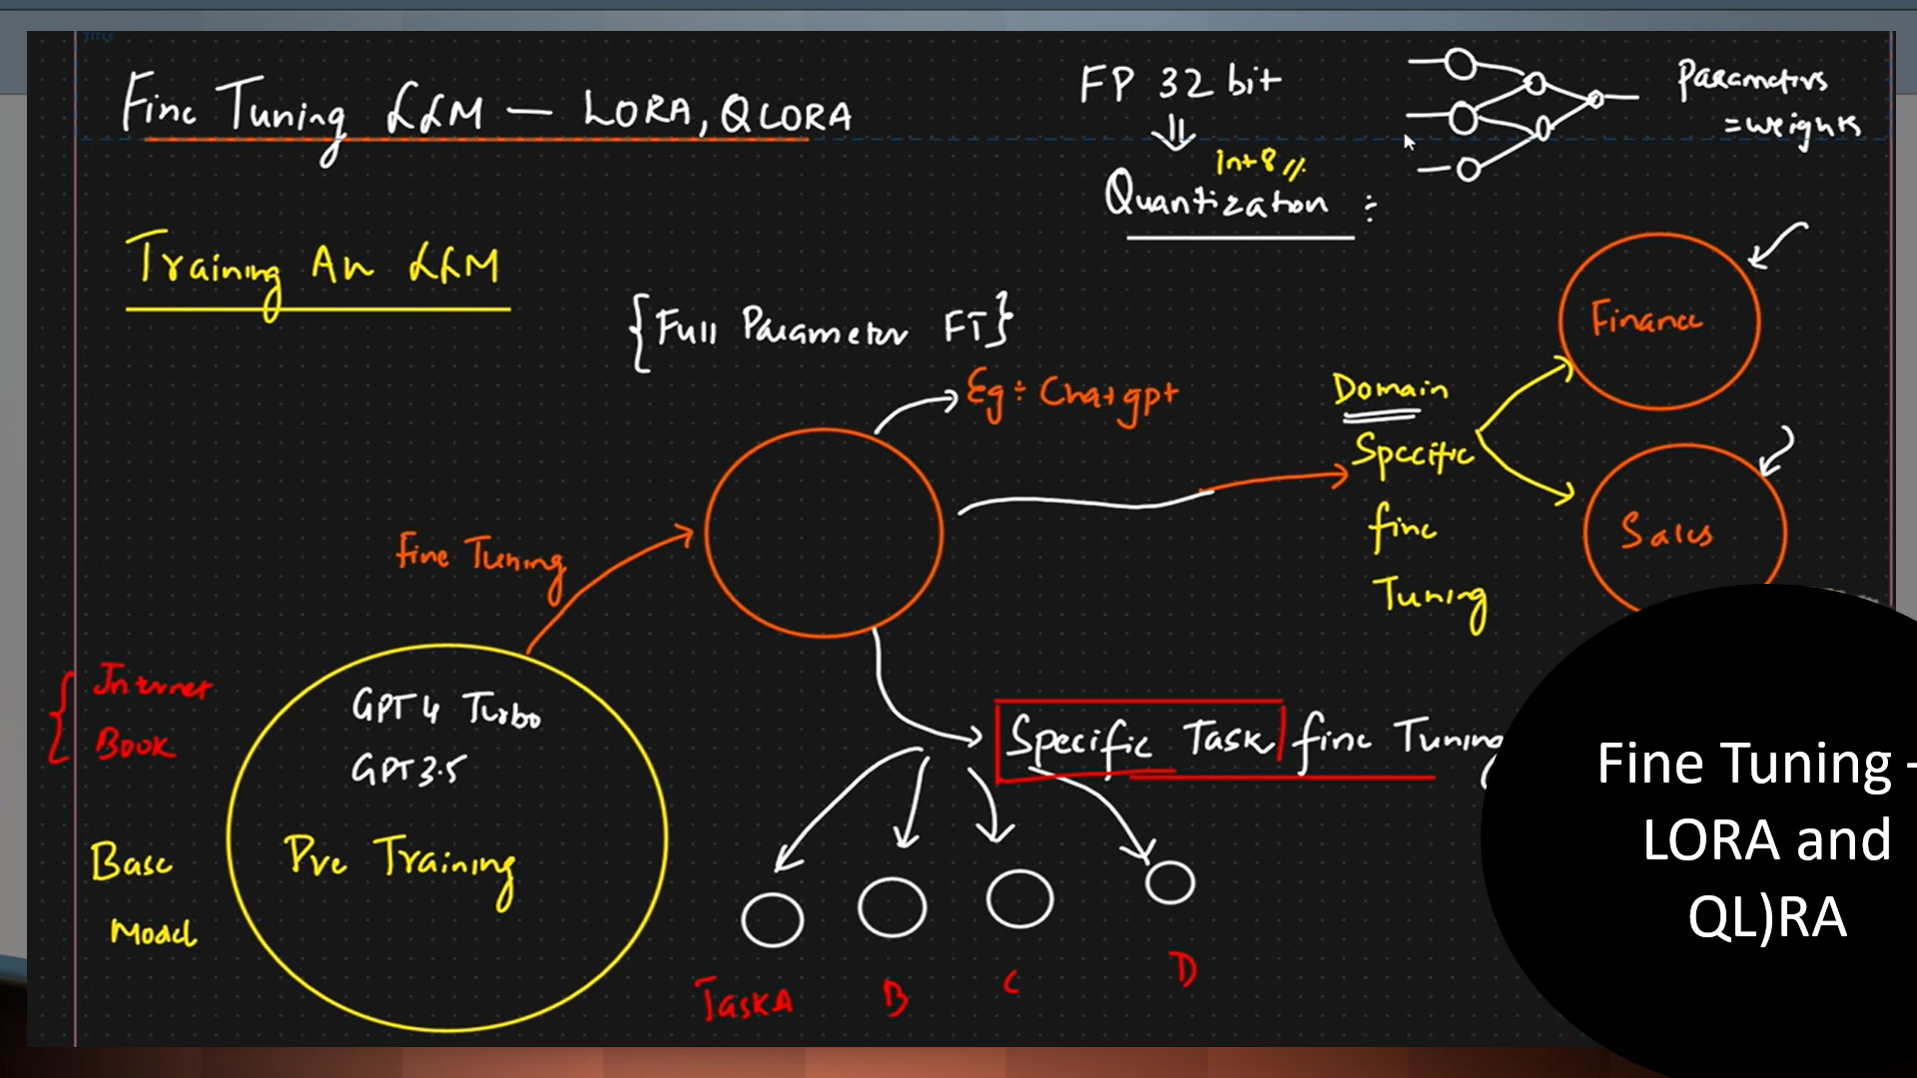

Slide 41
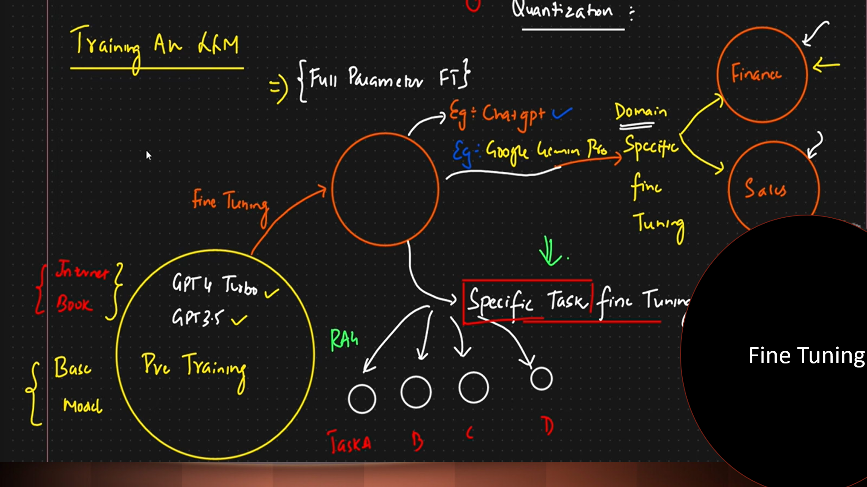

Slide 42
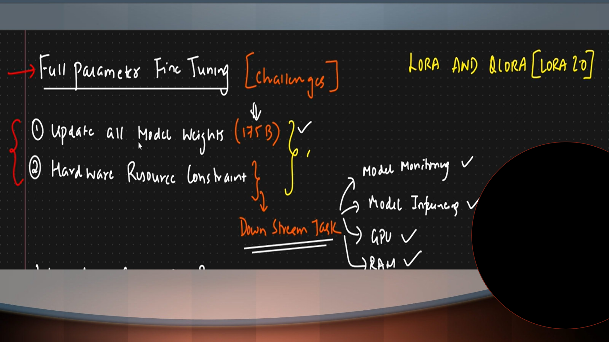

Slide 43
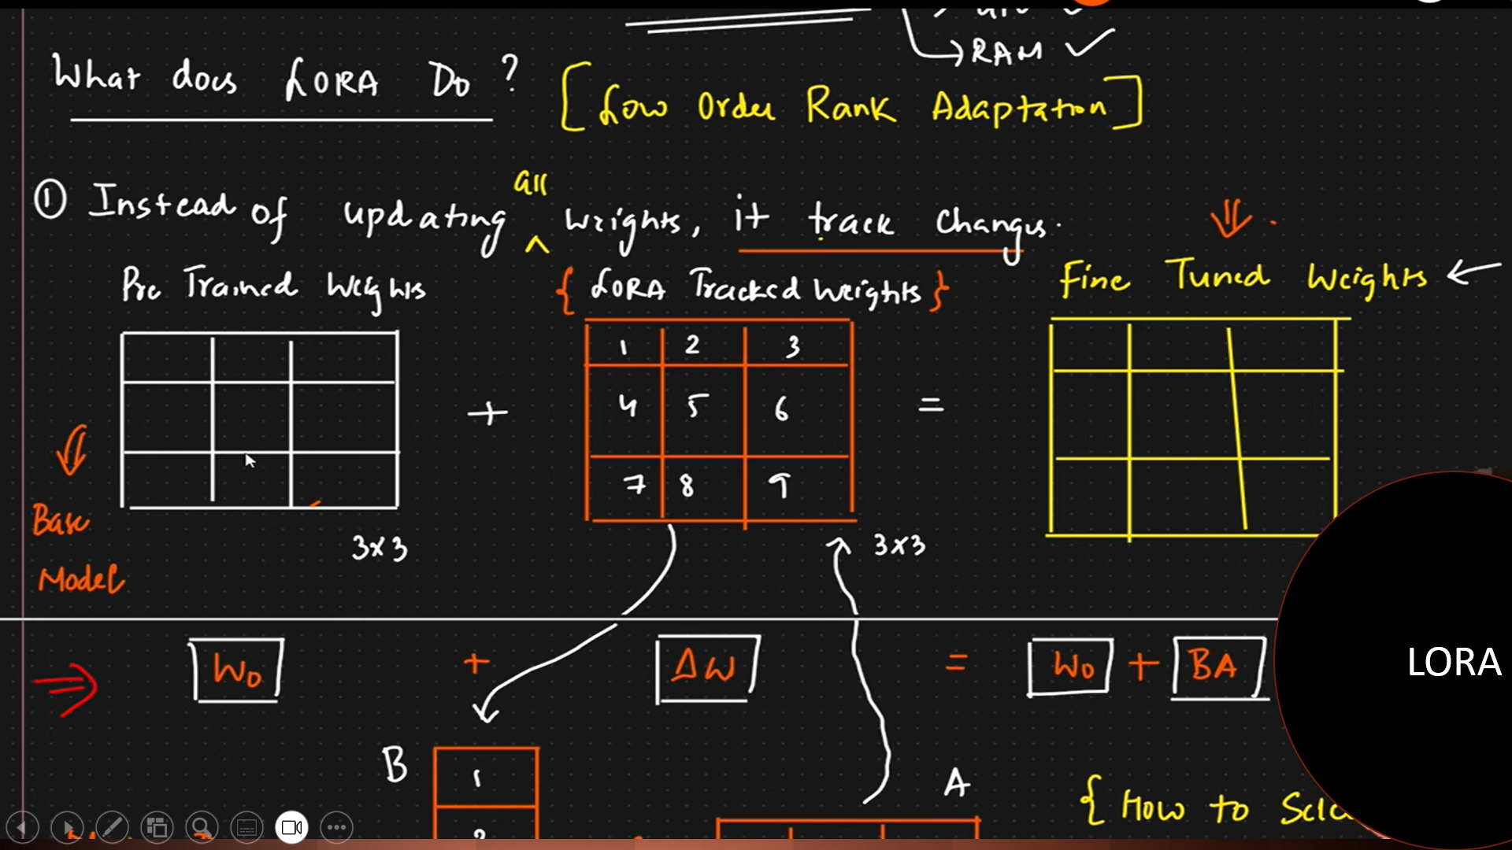
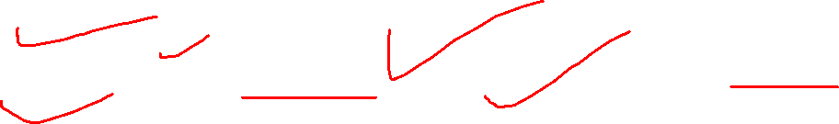

Slide 44
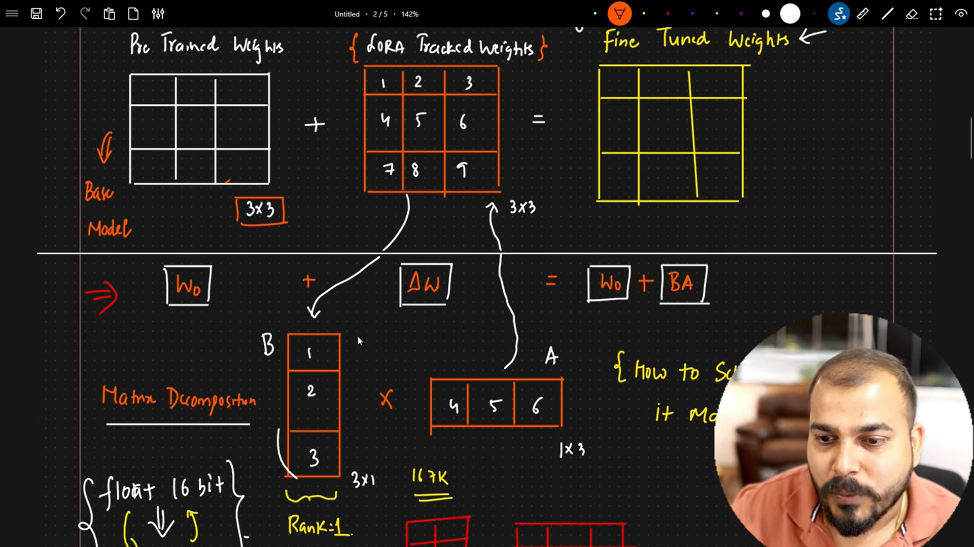
Matrix Decomposition

Slide 45
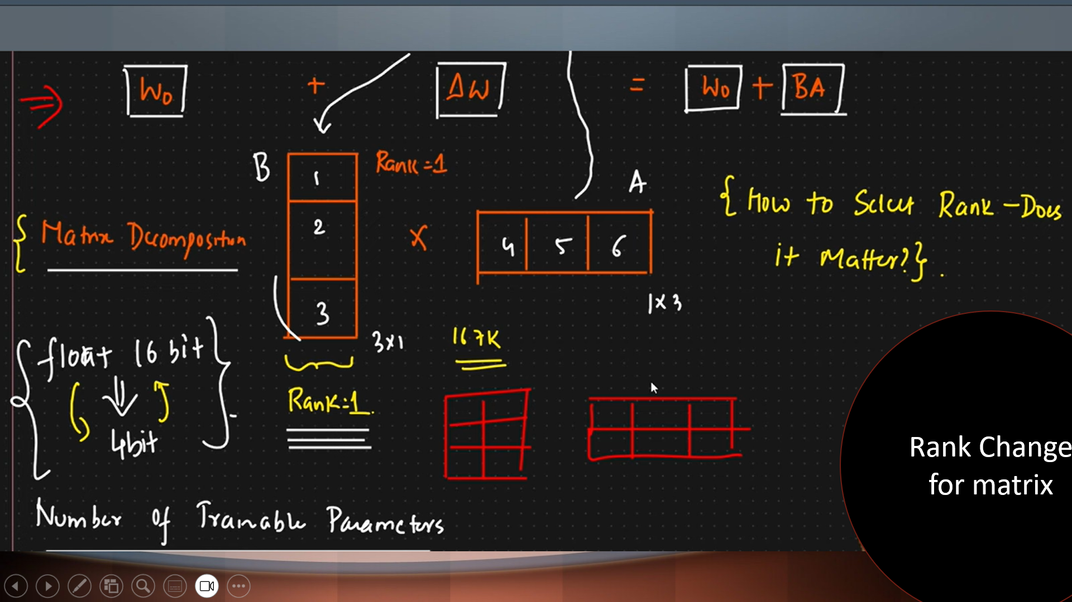

Slide 46
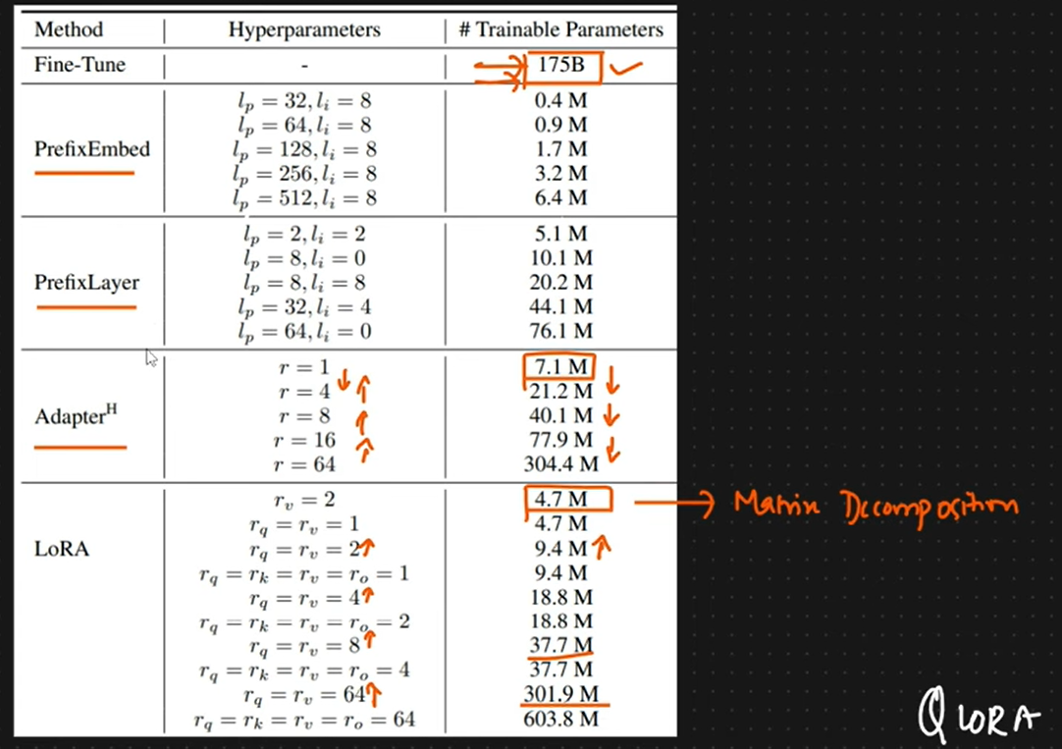
Method and Trainable Parameters

Slide 47
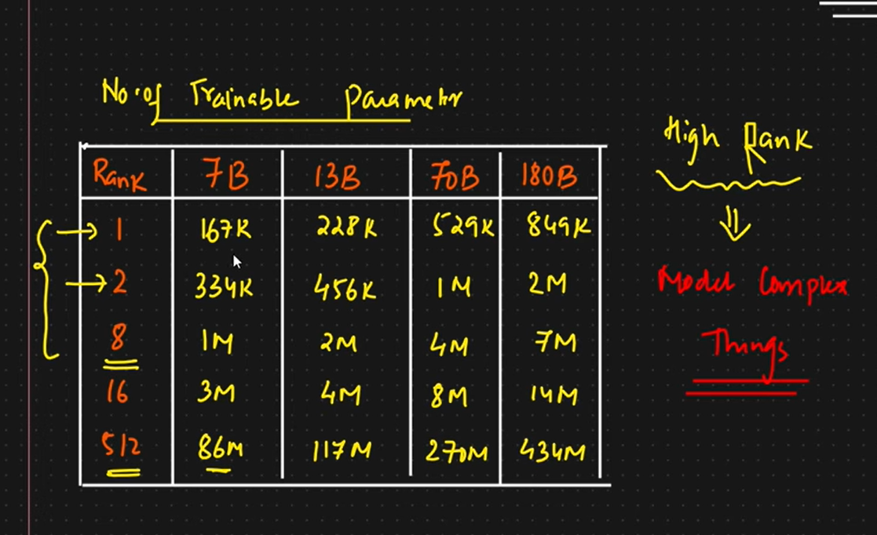
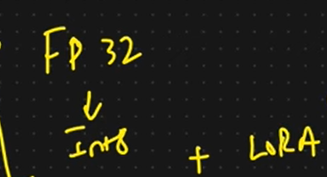

Slide 48
Implementation of LoRA with BERT on Emotion Detection

Slide 49
Steps - LORA_Fine_Tuning_Model.ipynb
1. Installing Required Libraries - We use Hugging Face’s transformers, datasets, peft, accelerate and evaluate libraries for model training, LoRA fine-tuning and evaluation.
!pip install transformers datasets peft accelerate evaluate
2. Importing Dependencies
3. Loading the Dataset
4. Preprocessing Data
5. Applying LoRA Configuration
6. Training the Model
7. Testing the Model on Custom Sentences

Slide 50
Fine-tuning-an-LLM-using-LoRA
https://github.com/fshnkarimi/Fine-tuning-an-LLM-using-LoRA/blob/main/FineTuning_LoRA.ipynb - This repository is inspired by the article "Fine-tuning Large Language Models (LLMs)" and contains code for training a text classification model using the Stanford Sentiment Treebank (SST-2) dataset and LoRA (Low-Rank Adaptation of Large Language Models) fine-tuning.
FineTuning_LoRA.ipynb

Slide 51
QLoRA (Quantized LoRA)

Slide 52
QLoRA - QLORA_FINE_TUNING_MODEL.ipynb
It works by loading the base language model in a highly compressed 4-bit quantized format, drastically reducing memory usage, while training small LoRA adapters in higher precision. During fine-tuning, only these adapters are updated, compensating for any quantization errors and preserving model performance. This approach allows you to efficiently fine-tune massive models on standard GPUs, combining aggressive memory savings with the parameter efficiency of LoRA and maintaining competitive results.
Training Process:
The pretrained model is loaded with quantized 4-bit weights.
Only the LoRA adapters are updated during training.
Libraries like BitsAndBytes (for quantization) and PEFT (for LoRA) are used together for implementation.
Example code involves setting up quantization configs, enabling gradient checkpointing, and applying LoRA adapters to target modules (e.g., query, key, value layers).
QLORA_FINE_TUNING_MODEL.ipynb

Slide 53
4. Reinforcement Learning with Human Feedback (RLHF)
Uses human ratings to teach a model to align outputs with human preferences.
Involves three steps: generate outputs, train a reward model from human feedback and optimize model behavior using reinforcement learning (like PPO).
Ideal for tasks requiring alignment with human values and nuanced preferences such as generating helpful, safe or ethical content.

Slide 54
RLHF process typically involves the following steps
Collecting human feedback: Human evaluators are asked to rate or compare the outputs of the language model based on certain criteria, such as coherence, relevance, or overall quality.
Training a reward model: The human feedback is used to train a reward model that predicts the human ratings or preferences. This reward model is typically a smaller model that is trained to capture the patterns and preferences expressed by the human evaluators.
Fine-tuning the language model: The language model is fine-tuned using reinforcement learning, with the reward model providing the reward signal. The goal is to maximize the expected cumulative reward, which corresponds to generating outputs that are preferred by humans.

Slide 55
approach fine-tuning
Method | Best When
Full | You have compute and need total control or major language/domain shift
LoRA | You have moderate resources and want efficient tuning
QLoRA | You have limited resources (low VRAM) and want to fine-tune large models
RLHF | You want to match output to human preferences
RLVR | You want to optimize based on verifier or bespoke reward models

Slide 56
Fine-tuning libraries
Managed fine-tuning | Meta offers a managed fine-tuning service for Llama, which is available as part of Llama API. This service abstracts most of the fine-tuning process, requiring you only to provide a dataset for training and evaluation. After your model has been fine-tuned, you can download the fine-tuned model and run it on your own hardware or infrastructure
PyTorch torchtune | PyTorch's torchtune library provides first-party support for a wide variety of fine-tuning methods, including full fine-tuning, PEFT methods like LoRA and QLoRA, and reinforcement learning methods like RLHF and RLVR. It also includes out-of-the-box support for the most popular open source models, including Llama.

Slide 57
End-to-End fine-tuning lifecycle
Downloading model checkpoints and datasets
Training recipes for fine-tuning Llama3 using full fine-tuning, LoRA, and QLoRA
Support for single-GPU fine-tuning capable of running on consumer-grade GPUs with24GB of VRAM
Scaling fine-tuning to multiple GPUs using PyTorch FSDP
Log metrics and model checkpoints during training using Weights & Biases
Evaluation of fine-tuned models using EleutherAI’s LM Evaluation Harness
Post-training quantization of fine-tuned models via TorchAO
Interoperability with inference engines including ExecuTorch

Slide 58
Fine tuning a model
Select Base Model: Choose a pre-trained model based on our task and compute budget.
Choose Fine-Tuning Method: Select the most appropriate method like Instruction Fine-Tuning, Supervised Fine-Tuning, PEFT, lora, qlora, etc based on the task and dataset.
Prepare Dataset: Structure our data for task-specific training, ensuring the format matches the model's requirements.
Training: Use frameworks like TensorFlow, PyTorch or high-level libraries like Transformers to fine-tune the model.
Evaluate and Iterate: Test the model, refine it as necessary and re-train to improve performance.

Slide 59
Working of Fine-Tuning
Select a Pre-Trained Model: which has been trained on a large, diverse dataset. Popular pre-trained models includes BERT for NLP tasks, VGG and ResNet for image classification tasks and GPT models for text generation.
Freeze Initial Layers: freeze the weights of the earlier layers in the model. These layers capture basic features like edges or textures in images or simple words in text. Freezing these layers reduces the computational load as only the later layers will be trained.
Update Later Layers: that specialize in more specific features. These layers are typically fine-tuned to adjust the weights based on the new task. For example if we're fine-tuning a language model for sentiment analysis then the final layers will adjust to classify the sentiment of the input text.
Use a Smaller Learning Rate: A key principle in fine-tuning is using a smaller learning rate compared to training from scratch. This ensures that the pre-trained weights are not drastically changed but are adjusted just enough to perform well on the new task.
Evaluate and Refine: After training it's important to evaluate the performance of the fine-tuned model on the specific task. Based on the evaluation we may continue to adjust the learning rate, fine-tune more layers or apply other modifications until the model performs optimally.

Slide 60
Implementing Fine Tuning Large Language Model using DialogSum Database
Let us fine tune a model using PEFT LoRa Method. We will use flan-t5-base model and DialogSum database.
Flan-T5 is the instruction fine-tuned version of T5 release by Google.
DialogSum is a large-scale dialogue summarization dataset, consisting of 13,460 (Plus 100 holdout data for topic generation) dialogues with corresponding manually labeled summaries and topics.
Fine Tuning Large Language Model using DialogSum Database.ipynb

Slide 61
Step 1: Install Necessary Libraries
The following commands install the required libraries for the task, including Hugging Face Transformers, Datasets and PEFT (Parameter-Efficient Fine-Tuning). These libraries enable model loading, training and fine-tuning.
!pip install datasets
!pip install transformers
!pip install evaluate
!pip install accelerate - U
!pip install transformers[torch]
!pip install peft

Slide 62
Step 2: Set Up Environment
Configure the device for computation, using GPU if available. Import all necessary libraries for dataset handling, model loading, tokenization and evaluation.
import torch
device = 'cuda' if torch.cuda.is_available() else 'cpu'
from datasets import load_dataset
from transformers import AutoModelForSeq2SeqLM, AutoTokenizer, TrainingArguments, Trainer, GenerationConfig
import evaluate
import pandas as pd
import numpy as np

Slide 63
Step 3: Load Dataset
Load the Hugging Face dataset for dialogue summarization. In this example, we use the "knkarthick/dialogsum" dataset.
huggingface_dataset_name = "knkarthick/dialogsum"
dataset = load_dataset(huggingface_dataset_name)

Slide 64
Step 4: Load Pre-trained Model and Tokenizer
Use a pre-trained T5 model (google/flan-t5-base) for sequence-to-sequence learning and initialize its tokenizer.
model_name = "google/flan-t5-base"
base_model = AutoModelForSeq2SeqLM.from_pretrained(model_name)
tokenizer = AutoTokenizer.from_pretrained(model_name)

Slide 65
Step 5: Check Trainable Parameters
Define a function to calculate and print the percentage of trainable parameters in the model.
def print_number_of_trainable_model_parameters(model):
trainable_model_params = 0
all_model_params = 0
for _, param in model.named_parameters():
all_model_params += param.numel()
if param.requires_grad:
trainable_model_params += param.numel()
return f"trainable model parameters: {trainable_model_params}\nall model parameters: {all_model_params}\npercentage of trainable model parameters: {100 * trainable_model_params / all_model_params:.2f}%"
print(print_number_of_trainable_model_parameters(base_model))

Slide 66
Step 6: Perform Baseline Inference
Test the pre-trained model on a sample from the test set to evaluate its performance before fine-tuning.
i = 20
dialogue = dataset['test'][i]['dialogue']
summary = dataset['test'][i]['summary']
prompt = f"Summarize the following dialogue {dialogue} Summary:"
input_ids = tokenizer(prompt, return_tensors="pt").input_ids
output = tokenizer.decode(base_model.generate(input_ids, max_new_tokens=200)[0], skip_special_tokens=True)
print(f"Input Prompt : {prompt}")
print("--------------------------------------------------------------------")
print("Human evaluated summary ---->")
print(summary)
print("---------------------------------------------------------------------")
print("Baseline model generated summary : ---->")
print(output)

Slide 67
Step 7: Tokenize Dataset
Tokenize the dataset to prepare it for training. The function generates input and label IDs, truncating or padding them to a fixed length.
def tokenize_function(example):
start_prompt = 'Summarize the following conversation.\n\n'
end_prompt = '\n\nSummary: '
prompt = [start_prompt + dialogue + end_prompt for dialogue in example["dialogue"]]
example['input_ids'] = tokenizer(prompt, padding="max_length", truncation=True, return_tensors="pt").input_ids
example['labels'] = tokenizer(example["summary"], padding="max_length", truncation=True, return_tensors="pt").input_ids
return example
tokenized_datasets = dataset.map(tokenize_function, batched=True)
tokenized_datasets = tokenized_datasets.remove_columns(['id', 'topic', 'dialogue', 'summary'])
tokenized_datasets = tokenized_datasets.filter(lambda example, index: index % 100 == 0, with_indices=True)

Slide 68
Step 8: Apply PEFT with LoRA Configuration
Use PEFT (Parameter-Efficient Fine-Tuning) to minimize training time and resource usage by tuning only specific layers.
from peft import LoraConfig, get_peft_model, TaskType
lora_config = LoraConfig(
task_type=TaskType.SEQ_2_SEQ_LM,
r=8,
lora_alpha=32,
lora_dropout=0.1,
)
peft_model_train = get_peft_model(base_model, lora_config)
print(print_number_of_trainable_model_parameters(peft_model_train))

Slide 69
Step 9: Define Training Arguments
Set up training configurations, including batch size, learning rate and the number of epochs.
output_dir = "./peft-dialogue-summary-training"
peft_training_args = TrainingArguments(
output_dir=output_dir,
auto_find_batch_size=True,
learning_rate=1e-3,
num_train_epochs=5,
)

Slide 70
Step 10: Train the Model
Use Hugging Face Trainer API to train the PEFT-enabled model.
peft_trainer = Trainer(
model=peft_model_train,
args=peft_training_args,
train_dataset=tokenized_datasets["train"],
)
peft_trainer.train()

Slide 71
Step 11: Save the Fine-Tuned Model
Save the trained PEFT model and tokenizer for future use.
peft_model_path = "./peft-dialogue-summary-checkpoint-local"
peft_trainer.model.save_pretrained(peft_model_path)
tokenizer.save_pretrained(peft_model_path)

Slide 72
Step 12: Load and Test Fine-Tuned Model
Load the fine-tuned model and test its performance on the same input prompt.
from peft import PeftModel
peft_model_base = AutoModelForSeq2SeqLM.from_pretrained("google/flan-t5-base")
peft_model = PeftModel.from_pretrained(peft_model_base, peft_model_path, is_trainable=False)
peft_model_outputs = peft_model.generate(input_ids=input_ids, generation_config=GenerationConfig(max_new_tokens=200, num_beams=1))
peft_model_text_output = tokenizer.decode(peft_model_outputs[0], skip_special_tokens=True)
print(f"Input Prompt : {prompt}")
print("--------------------------------------------------------------------")
print("Human evaluated summary ---->")
print(summary)
print("---------------------------------------------------------------------")
print("Baseline model generated summary : ---->")
print(output)
print("---------------------------------------------------------------------")
print("Peft model generated summary : ---->")
print(peft_model_text_output)

Slide 73
Sentiment analysis using fine tuning
https://www.datacamp.com/tutorial/fine-tuning-large-language-models
https://www.youtube.com/watch?v=3gj8wyZOkV8&list=PLQxDHpeGU14BX9L83JMSoKHsdIjv98BGn&index=9
quickstart_peft_finetuning.ipynb
FineTuning_LoRA.ipynb
https://github.com/sunnysavita10/Complete-LLM-Finetuning/tree/main

Slide 74
Thank you

